Slide 1
DAYALEKTOR
Belchez, Maica L.
Carpio, Aira Joyce A.
Gardon, Jana Marie G.
Haboc, Florence Gail G.

Slide 2
Event Table

Slide 3
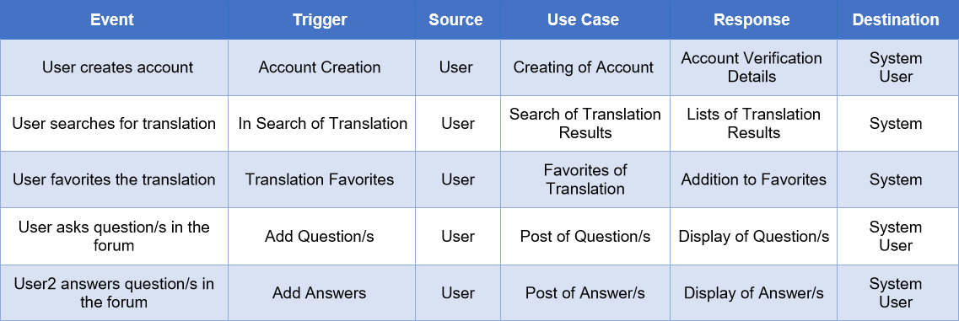

Slide 4
Use Case Full Description

Slide 5
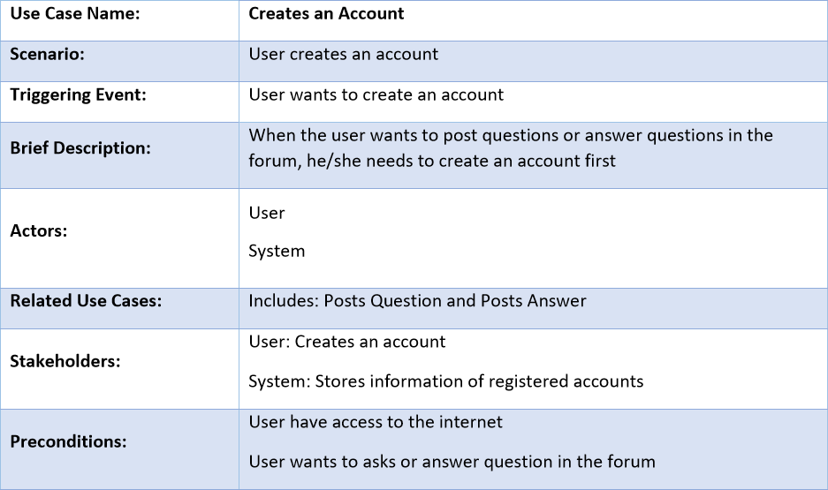
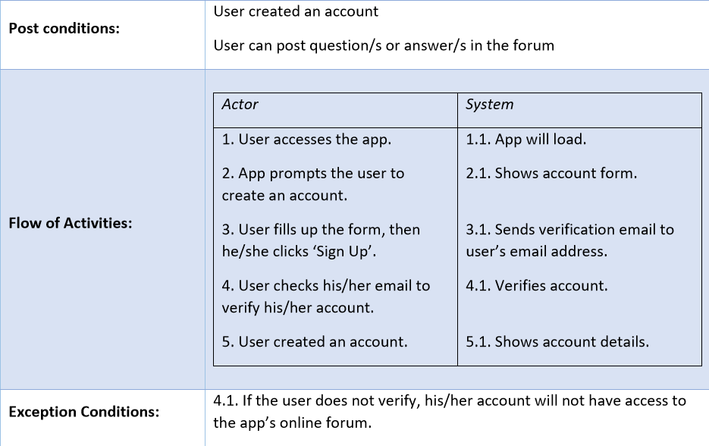

Slide 6
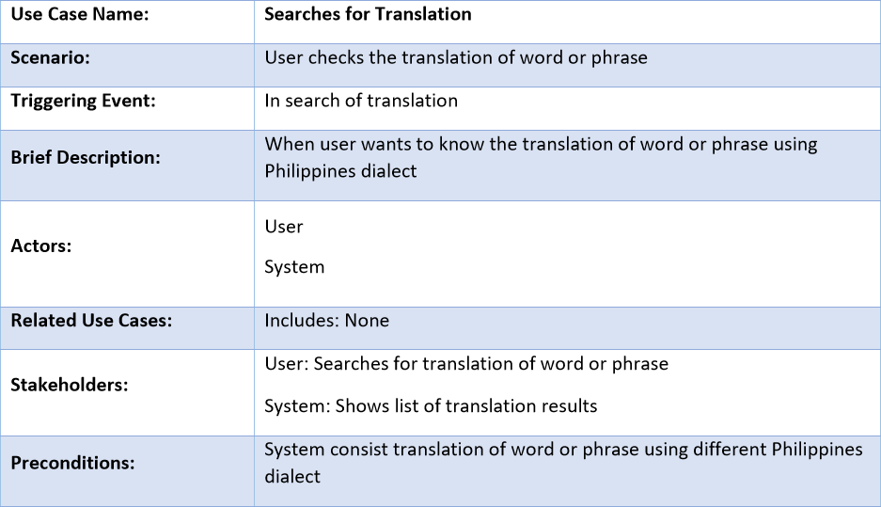
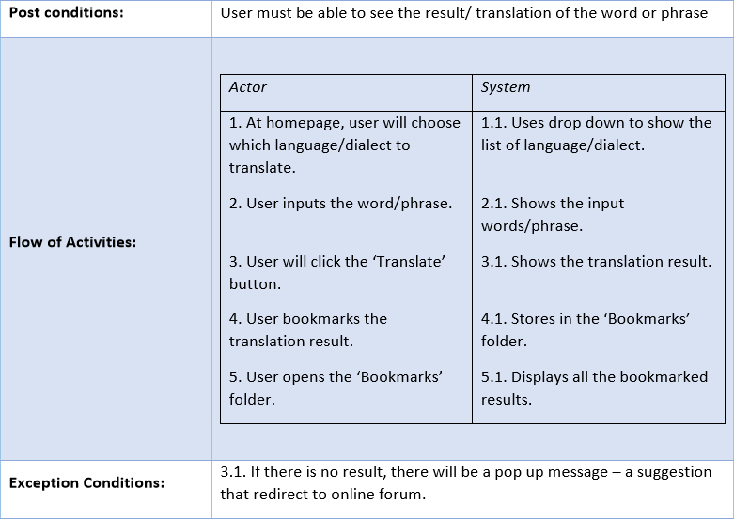

Slide 7
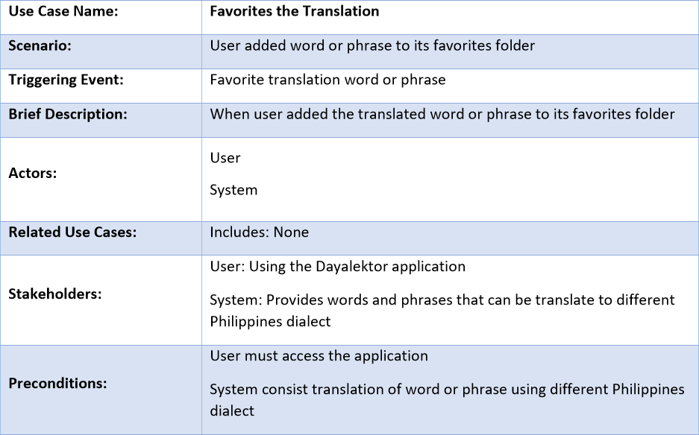
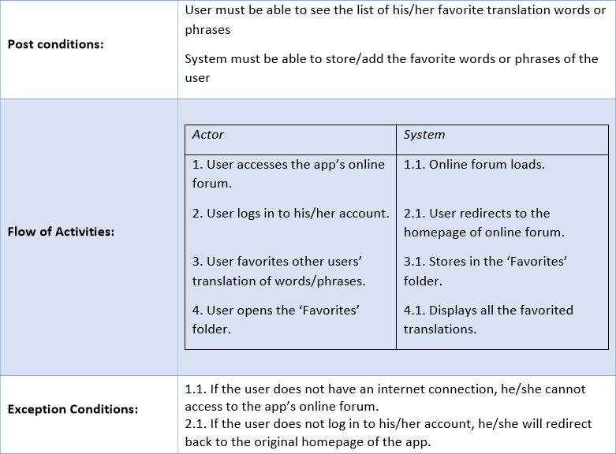

Slide 8
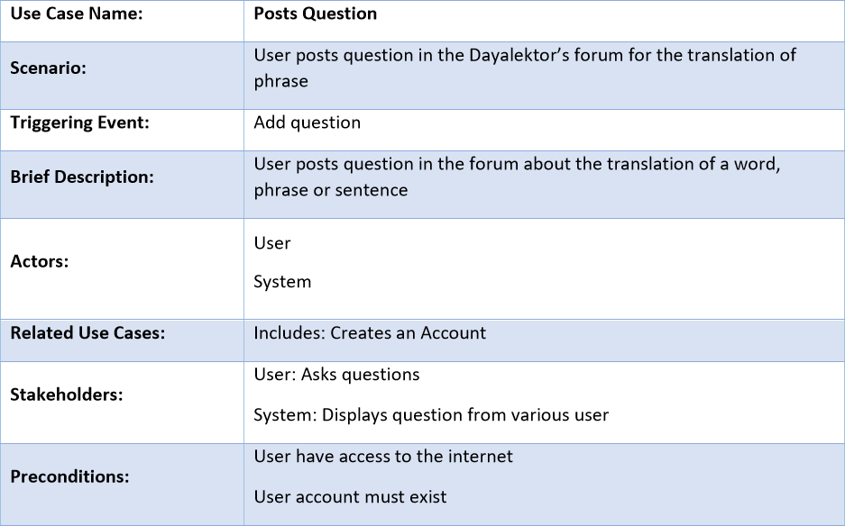
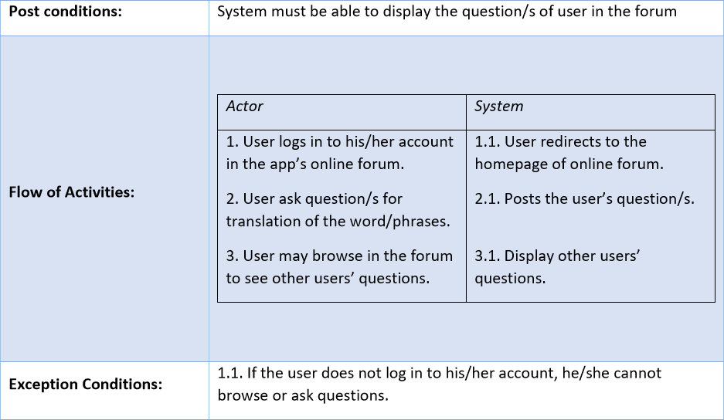

Slide 9
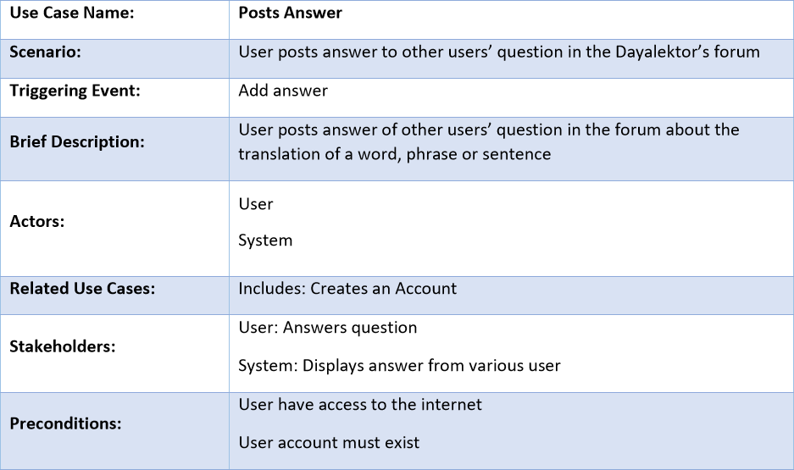
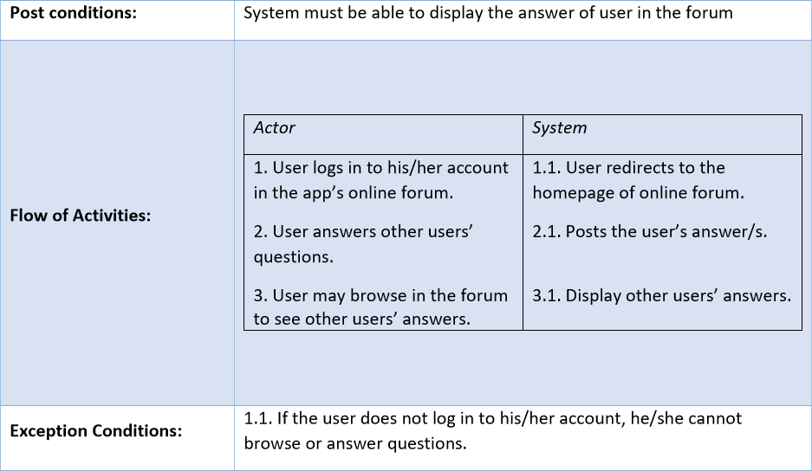

Slide 10
Entity Relationship Diagram

Slide 11
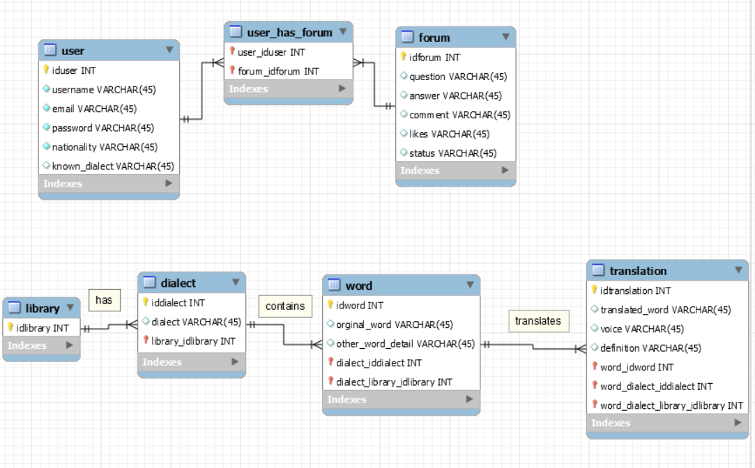

Slide 12
Prototype

Slide 13
Pitch Video

